Slide 1
Wine Reviews
2조
김현영, 조용환, 조성민

Slide 2
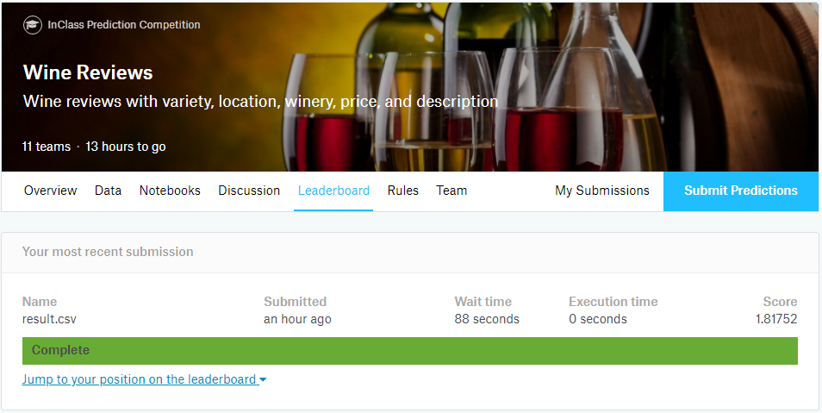
Project – Wine Reviews
Competitions (e.g., Kaggle)
Understanding of business problem
Problem formalization
Data collecting
Data preprocessing
Modeling
Way to evaluate model in real life
Way to deploy model

Slide 3
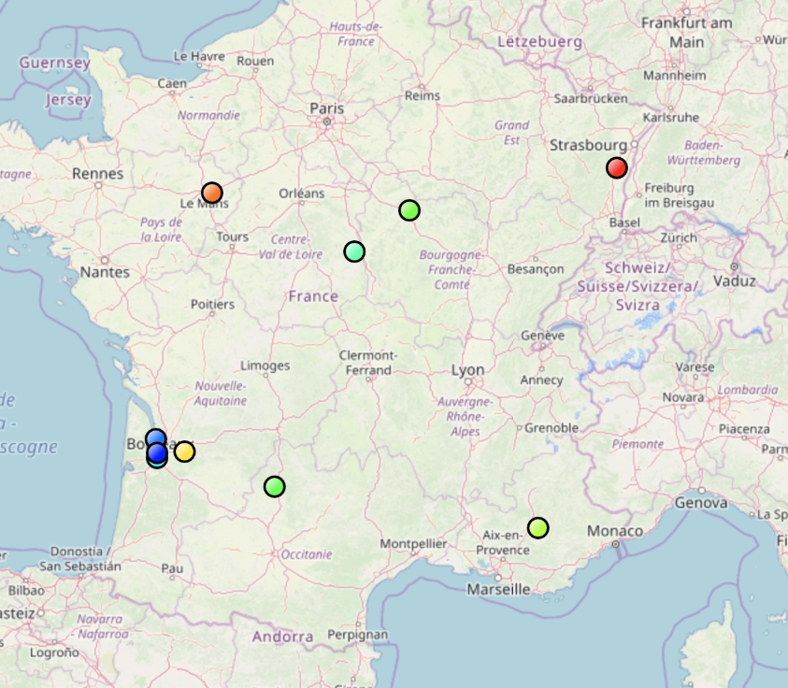
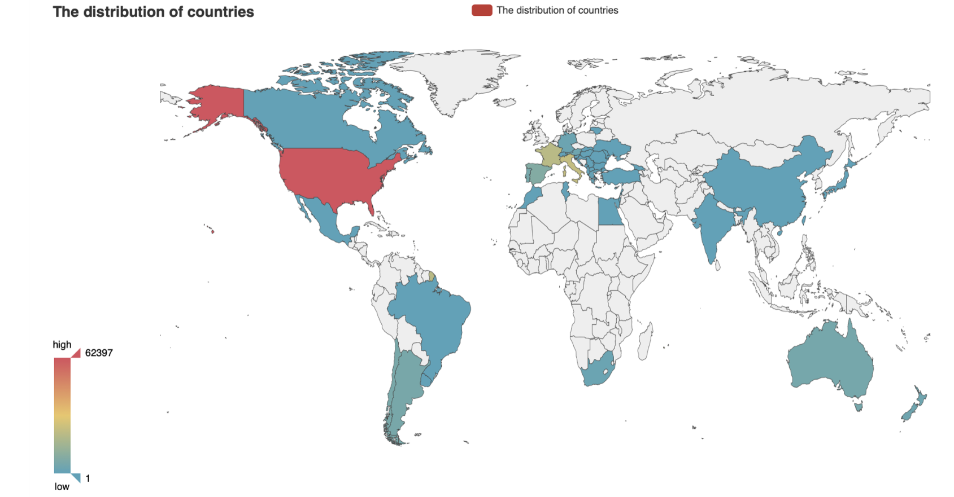
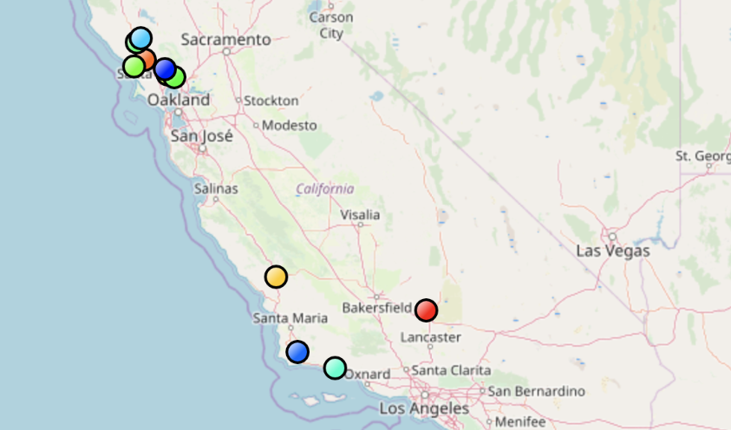
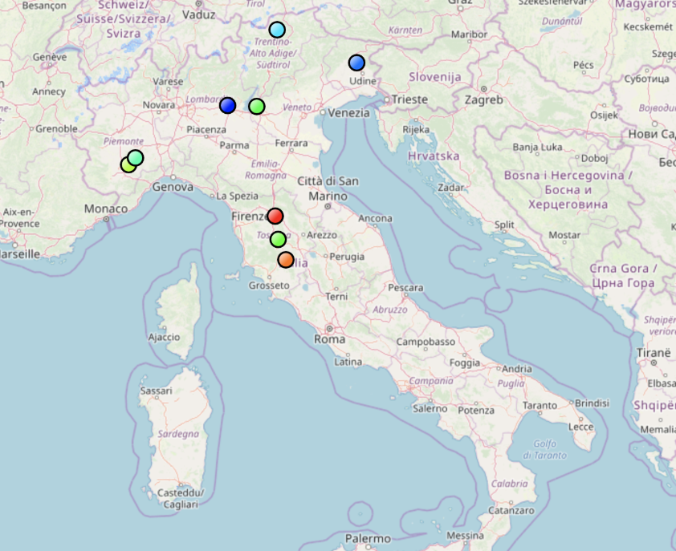
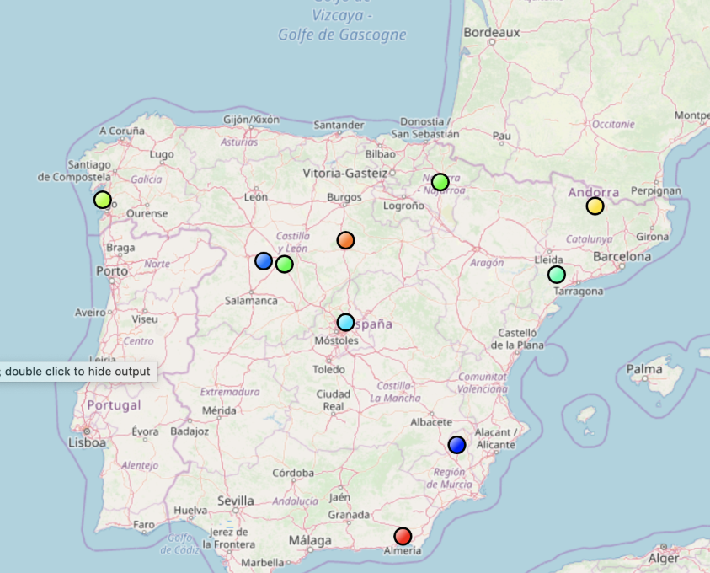
The Distribution Of Countries
Winery | Point(Q2)
22093 | 89
Winery | Point(Q2)
32646 | 89
Winery | Point(Q2)
19540 | 88
Winery | Point(Q2)
6645 | 87

Slide 4
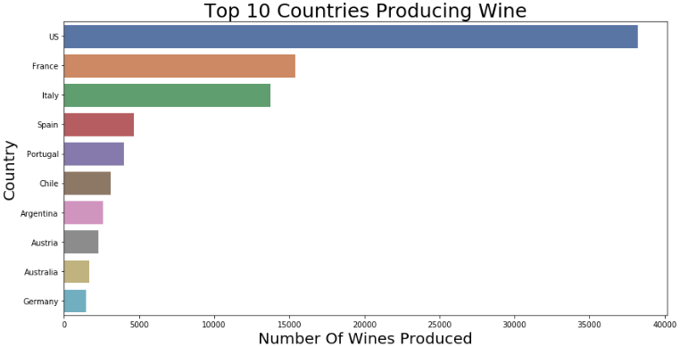
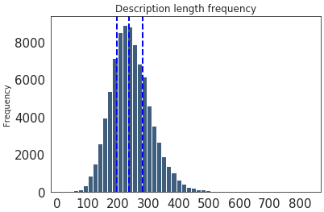
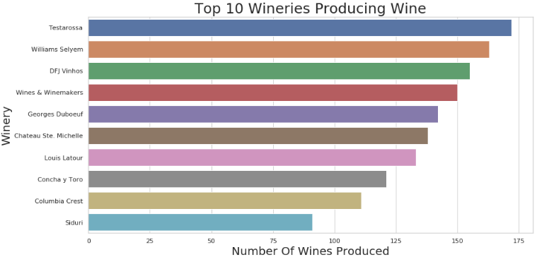
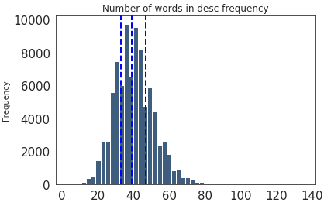
1. Understanding of business problem - EDA
1-1 Raw Data 훑어보기
- Top 10 Countries
- Description Frequency
- Top 10 Wineries

Slide 5
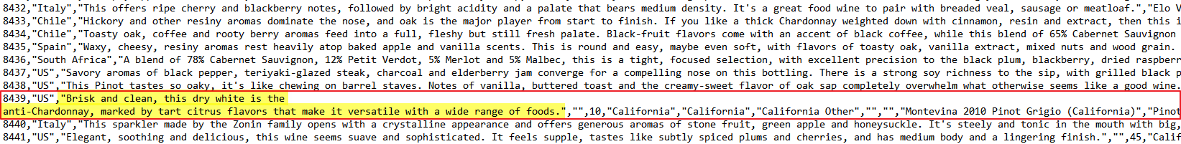
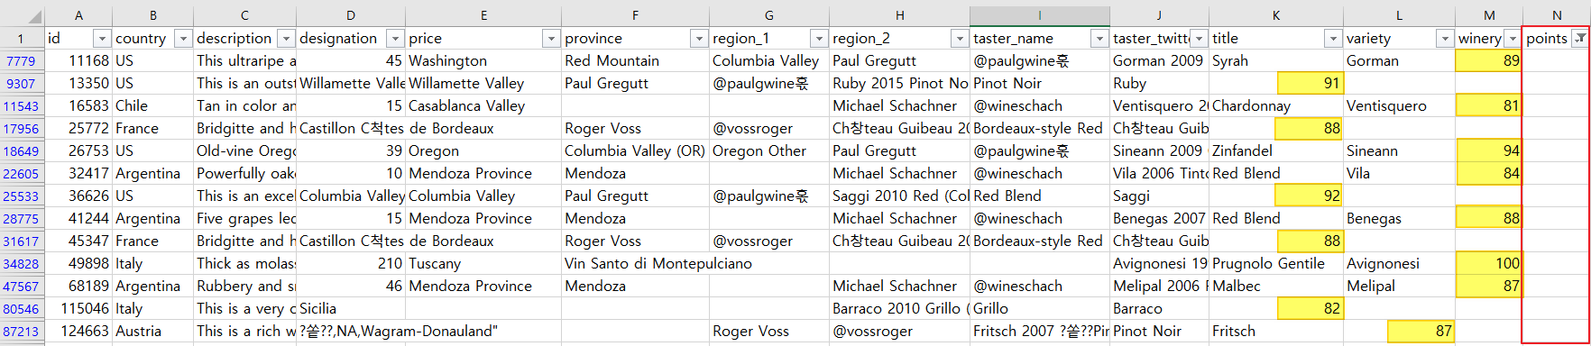
1. Understanding of business problem - EDA
- 이상치 제거
- Data 보정

Slide 6
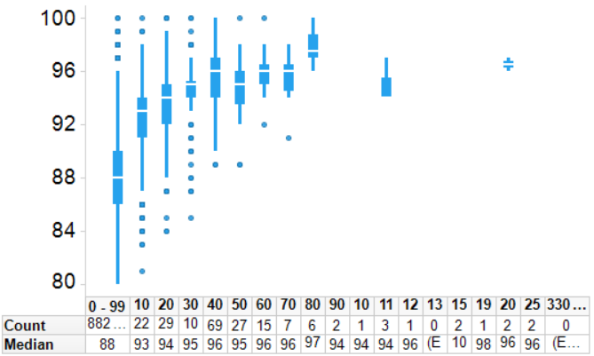
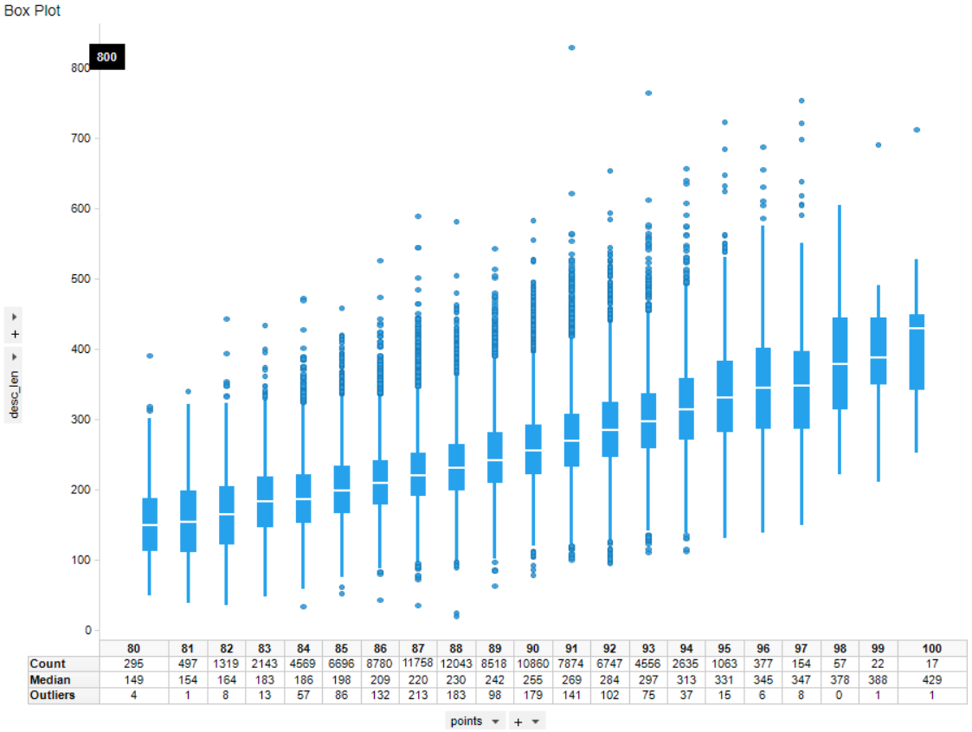
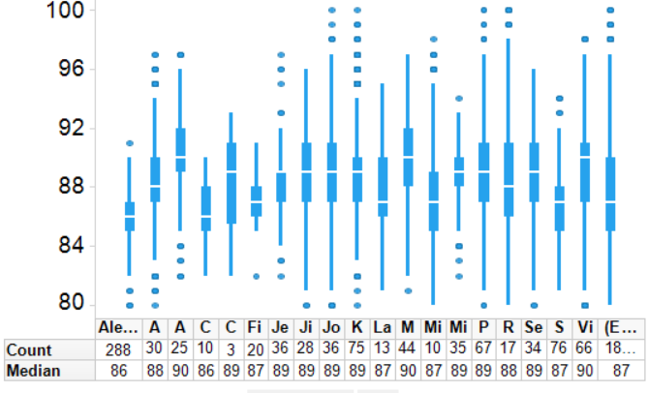
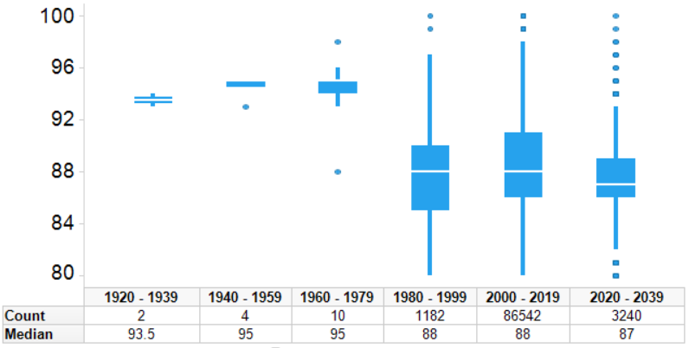
1. Understanding of business problem - EDA
Price별 Point
Description Length별 Point
Taster Name별 Point
Vintage별 Point

Slide 7
1. Understanding of business problem - EDA
구분 | No | Name | Description
Calc. Feature | 1 | Taster Name Q2 | Taster Name별 Median Point
 | 2 | Taster Name STD | Taster Name별 Point STD
 | 3 | Price_ | Price 값이 없으면 0
 | 4 | Price_1 | Price 값이 없으면 1
 | 5 | Price_Modify | Price 별 Point - 100단위
 | 6 | designation_modify | designation length
 | 7 | description_modify | description length
 | 8 | varienty_modify | variety별 price / point R^2
 | 9 | vintage_ | vintage, NV는 2030년처리
 | 10 | vintage_modify | vintage별 point(NV는 0처리) - 10년단위
 | 11 | aged | 숙성도 (Title 에서 추출)
 | 12 | province_modify | province variety별 price / point R^2
New Feature | 1 | continent | 대륙정보
 | 2 | grade_germany | germany wine 평가 grade
 | 3 | grade_italy | italy wine 평가 grade
 | 4 | grade_spain | spain wine 평가 grade
 | 5 | grade_france | france wine 평가 grade
 | 6 | Rating_Avg | Vintage 점수
 | 7 | Maturity_Uni | Wine 숙성도
 | 8 | TOP-100 | TOP 100 wine (0/1)
 | 9 | VIP wine | 유명인, 행사 사용 wine
 | 10 | Paris_심판 | 파리의 심판 순위
- 상관성 분석 → 12 Calculated Features
- Domain Knowledge → 10 New Features

Slide 8
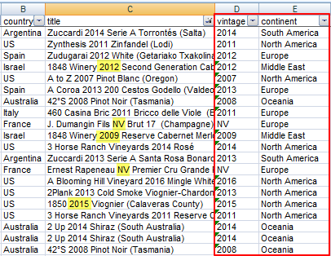
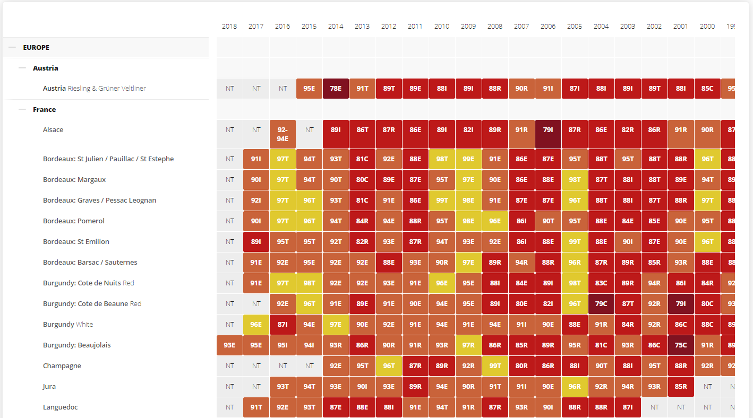
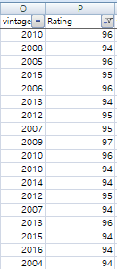
2. Feature Engineering
Title → Vintage 정보 추가
Country → Continent 정보 추가
Robert Parker – Vintage Chart 를 활용하여 Rating

Slide 9
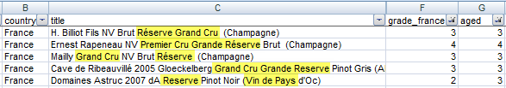
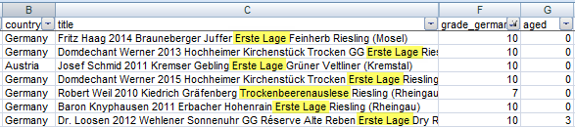
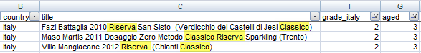
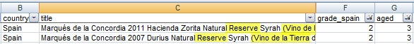
2. Feature Engineering
Title → 국가 별 와인 등급체계, 숙성도 추가
등급별 Feature 추가

Slide 10
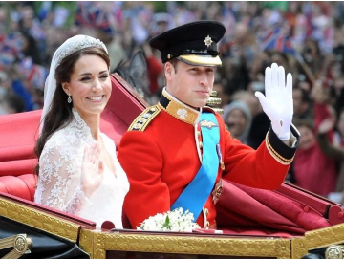


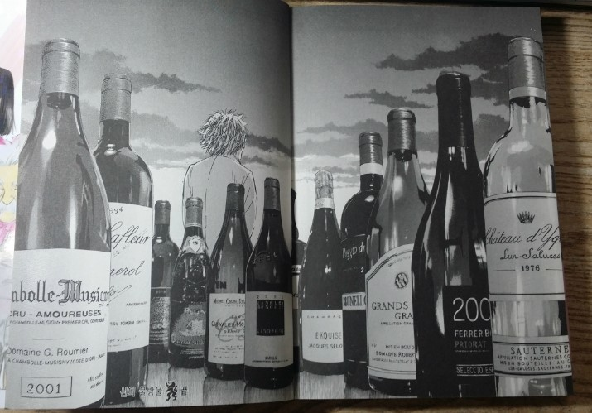
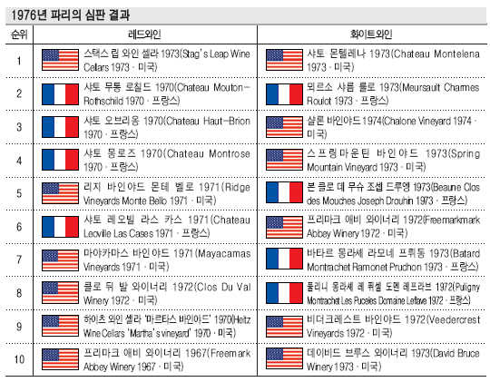
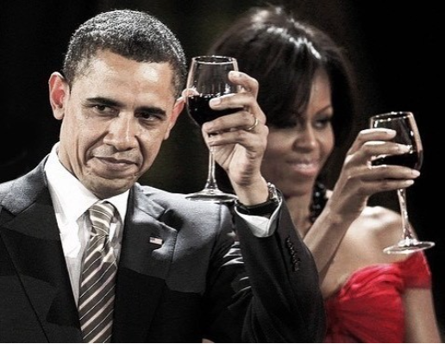
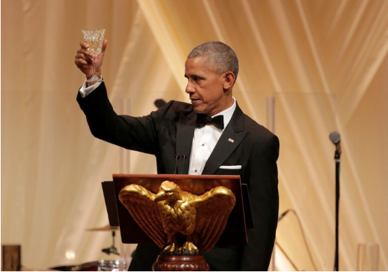
2. Feature Engineering
- 윌리엄 결혼식 와인
(Pol Roger Brut Reserve Champagne NV)
이건희 생일, 오바마 방한 환영 와인
(Chateau Montelena, Estate Cabernet Sauvignon, 2012)
신의물방울 와인
평론가 추천 와인
오바마 취임식 와인
(Duckhorns Vineyards Sauvignon Blanc, 2007)
(Schramsberg Blanc de Blanc, 2012)
- 파리의 심판 와인 (레드/화이트 10종)

Slide 11
2. Feature Engineering
22 Features 추가
12 Features (Calculated) + 10 Features (New Feature)
RMSE - 2.4
Feature Selection 진행
Noise가 있는 Feature들은 아쉽지만 많이 제거
11 Features : 5 Features (From Raw data) + 6 Features (New Feature)
구분 | No | Name | Description | RMSE
Feature | 1 | Taster Name Q2 | Taster Name별 Median Point | 0.07
 | 2 | Taster Name STD | Taster Name별 Point STD | 0.00
 | 3 | Price_ | Price 값이 없으면 0 | 0.00
 | 4 | Price_1 | Price 값이 없으면 1 | 0.00
 | 5 | Price_Modify | Price 별 Point - 100단위 | 0.01
 | 6 | designation_modify | designation length | 0.23
 | 7 | description_modify | description length | 0.32
 | 8 | varienty_modify | variety별 price / point R^2 | 0.00
 | 9 | vintage_ | vintage, NV는 2030년처리 | 0.04
 | 10 | vintage_modify | vintage별 point(NV는 0처리) - 10년단위 | 0.00
 | 11 | aged | 숙성도 (Title 에서 추출) | 0.00
 | 12 | province_modify | province variety별 price / point R^2 | 0.00
New Feature | 1 | continent | 대륙정보 | 0.02
 | 2 | grade_germany | germany wine 평가 grade | 0.03
 | 3 | grade_italy | italy wine 평가 grade | 0.02
 | 4 | grade_spain | spain wine 평가 grade | 0.04
 | 5 | grade_france | france wine 평가 grade | 0.03
 | 6 | Rating_Avg | Vintage 점수 | 0.04
 | 7 | Maturity_Uni | Wine 숙성도 | 0.00
 | 8 | TOP-100 | TOP 100 wine (0/1) | 0.00
 | 9 | VIP wine | 유명인, 행사 사용 wine | 0.00
 | 10 | Paris_심판 | 파리의 심판 순위 | 0.00
구분 | No | Name | Description | RMSE
Feature | 1 | Taster Name Q2 | Taster Name별 Median Point | 0.07
 | 2 | Price_Modify | Price 별 Point - 100단위 | 0.01
 | 3 | designation_modify | designation length | 0.23
 | 4 | description_modify | description length | 0.32
 | 5 | vintage_ | vintage, NV는 2030년처리 | 0.04
New Feature | 1 | continent | 대륙정보 | 0.02
 | 2 | grade_germany | germany wine 평가 grade | 0.03
 | 3 | grade_italy | italy wine 평가 grade | 0.02
 | 4 | grade_spain | spain wine 평가 grade | 0.04
 | 5 | grade_france | france wine 평가 grade | 0.03
 | 6 | Rating_Avg | Vintage 점수 | 0.04

Slide 12
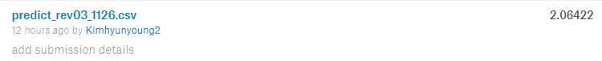

3. Modeling
Machine Learning
RMSE
65.9
Logistic Regresssion
1
2.3
Gradient Boosting
2
2.06
RandomForest
3
2.14
2.06?
Still Hungry!
AdaBoost
4
2.08
SVM
5
2.4
XGB
6
2.22

Slide 13
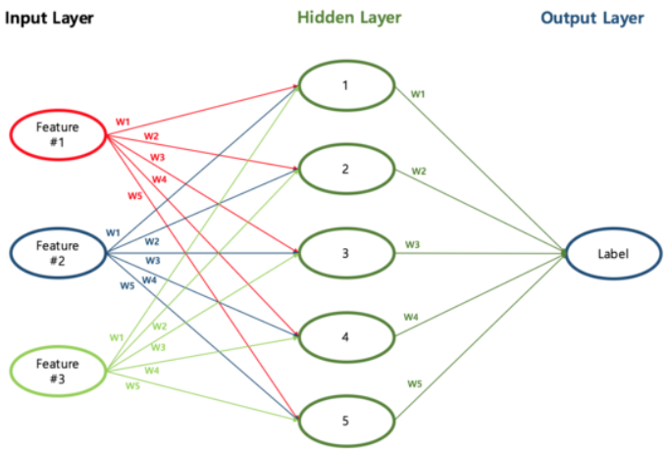
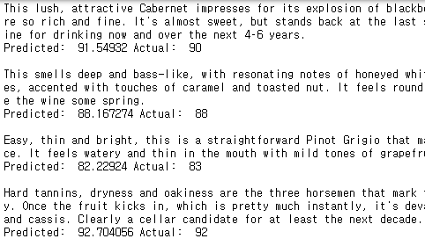
3. Modeling
Deep Learning - Description 분석
1.74?
Looks good!

Slide 14


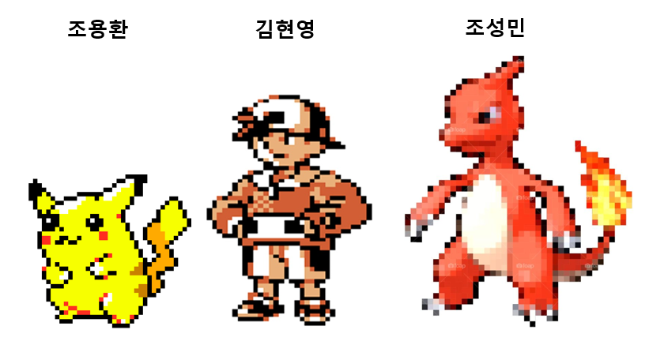
ENSEMBLE
6
LogisticRegression
XGB
1
5
SVM
GradientBoosting
AdaBoost
2
4
RandomForest
3

Slide 15
3. Modeling
RMSE
Mechine Learning
2.06?
Still Hungry!
Deep Learning
1.74?
Looks good!
Ensemble
1.65!

Slide 16
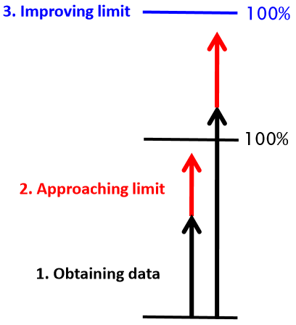

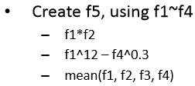
4. Plan
현업에 적용한다면?
EDA 를 통한 New Feature 발견

Slide 17

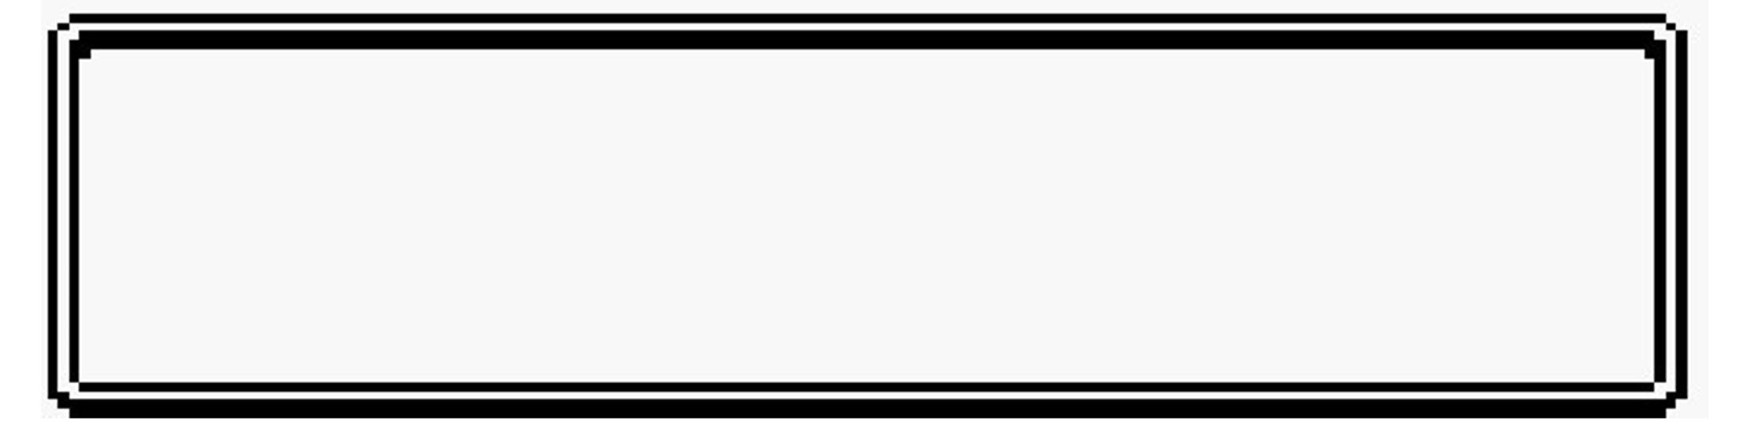
Q&A
IF YOU HAVE ANY QUESTION

